Slide 1
Delaware North Sportservice
NPO Volunteer Information
WELCOME TO THE 2018 SEASON
Notes:
NOTE TO FACILITATOR: This slide should be projected onto the screen as participants enter the room.

Slide 2
DELAWARE NORTH
Notes:
Let’s begin by giving you an overview of Delaware North. Where we started and who we are now….. And introduce you to some of our leaders, our vision and values,

Slide 3
Delaware North History
Founded in 1915 by three brothers - Charles, Marvin and Louis Jacobs
Left to Right: Charles, Louis & Marvin
Notes:
To have a better understanding of how far we have come in the past 102 years – the company was founded by the three Jacobs brothers, Charles, Marvin and Louis, in 1915.
Delaware North has grown from humble beginnings as a Buffalo popcorn vendor to a global market leader with an outstanding reputation as a world-class company in the food service and hospitality industries.

Slide 4
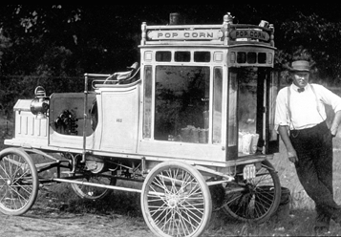
Branching Out
It all started with popcorn and peanuts
In 1930 – the Brothers took over concessions at Tiger Stadium in Detroit – the first Major League Ballpark contract.
It’s all about the relationships!
Canoe Concessions at Park in Buffalo, NY
Notes:
Marvin Jacobs started the concessions business by selling popcorn to patrons in the Academy Theater’s gallery, in Buffalo, N.Y., during the winter months. However, because there was no air conditioning, theaters generally closed during the summer.
To keep their employees working year-round, the three brothers looked for summer business outdoors, which eventually led to baseball. In 1919, the brothers expanded to a ballpark in Baltimore, and later entered into a contract with the team in Buffalo. They began building their relationship with baseball by working cooperatively with teams.
Next, in 1930 the brothers took over concessions at Tiger Stadium in Detroit - their first major league ballpark. At the end of that first year, Louis Jacobs handed Frank Navin, the Tiger’s owner, a check for $12,500. His explanation,…“You had a bad contract. We made a lot more money than we expected; a lot more than is fair to you. You’re entitled to this share of our profits.” He was really building a key relationship. Frank Navin spread the tale of the $12,500 check to other owners. When some of them had concessions problems, they turned to the Jacobs brothers. In 1932, the Depression forced the company to the brink of bankruptcy. They went to club owners for help and received it, demonstrating in the clearest possible terms the value of building relationships.

Slide 5
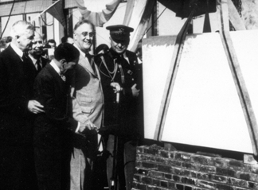
The Partnership Expands
Airports
Racetracks
Olympics
World’s Fair
International
Franklin D. Roosevelt at the opening of Washington National Airport
Notes:
The partnership expanded, baseball took off, and the company began business with airports and racetracks.
In 1940, Delaware North obtained their first airport contract at Washington National Airport. International interests included the 1960 Olympics in Rome, the Royal Ascot Race Track, U.K., racetracks in San Juan, Puerto Rico, Expo ‘67 in Montreal, and other ventures across Canada.
Upon Louis Jacobs’ death, his son Jeremy Jacobs took over the business while still in his twenties. Today, Jeremy M. Jacobs, son of Louis, is the Chairman and Owner of the Boston Bruins.

Slide 6
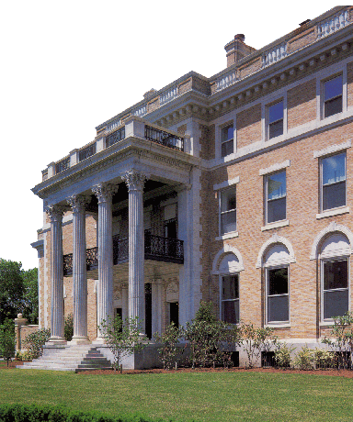
How Did Delaware North Get Its Name??
Notes:
Everyone always asks how Delaware North got its name. In 1979, Delaware North purchased the William Butler Mansion in Buffalo to save it from possible destruction, preserving and renovating it to be used as its new corporate headquarters. Over an 8-year period, the company completed the renovation at a cost of more than $6 million.
The branding process took place in the early 1980’s and we then rebranded our logo in 2014 and changed from “Delaware North Companies” to just Delaware North.
It was at this time that the company's business was so diverse that the Chairman decided it needed to change its name to more accurately reflect its new expanded business. After consulting with a well-known New York identity firm, a new name was presented to Jeremy Jacobs. It proved difficult to pronounce and few understood its meaning. It was then that Jeremy Jacobs looked out his window and declared that the new company name would be Delaware North, the intersection of the streets where the mansion still sits today.

Slide 7
DN Vision
Notes:
As a global leader in hospitality, Delaware North’s expertise lies in creating moments of delight for millions of guests. All of our hard work has led to unparalleled success for our company and we are looking to harness that energy to reach new heights. Getting there will depend on all of us, at every level of the organization, understanding and embracing the vision and values upon which Delaware North is built.

Slide 8
DN Values

Slide 9
GAME DAY INFORMATION

Slide 10
Game Day Information
Overview of new Check In process
Uniforms
What can you bring in
Tour of Check In/Elevator/Laundry

Slide 11
Game Day Information
Parking
2018 Carpool lot is TBD
We will be offering a carpool option for all volunteers, but we do not have an assigned location yet.

Slide 12
Volunteer Conduct
In order to provide excellent guest service, the following actions are not allowed:
Improper language toward/in front of co-volunteers, managers, guests or clients
False or malicious statements
Removing company records or items from property
Mischief, wrestling, pushing, throwing items, rough-housing or other types of horseplay
Possession of firearms, explosives, weapons
Physical violence
Willful neglect or misuse of company property
Insubordination

Slide 13
Volunteer Conduct
Autographs, Fraternization and Solicitation
Volunteers may not socialize, elicit services (including autographs or pictures) or ask for special treatment from players, player’s family, other celebrities, front office associates, suite holders, club seat holders. Deviations from this regulation will be considered a violation of company policy, subject to corrective action.
Patriotism
All staff within view of the flagpole in center field should face the American Flag and stand at attention whenever the “Star Spangled Banner” or another country’s national anthem is played. Any volunteer whose uniform requires a hat or visor must remove it at this time and place their right hand over their heart.
Smoking
Smoking and/or the use of tobacco products is not permitted while on Bank of America Stadium property. Bank of America Stadium is a NON Smoking facility, this includes e-cigarettes and vaporizers.

Slide 14
Volunteer Conduct
Promotional Items
All giveaways, promotional offers, and contests associated with the events are for ticketed guests only. Associates of Delaware North are not eligible to participate, nor are they to solicit such items. Deviations from this regulation will be considered a violation of company policy, subject to corrective action. Associates are not permitted to purchase game tickets for the purpose of collecting giveaway items while at the stadium during their shift.
Watching The Event
It is expected that you are working during your time in the stadium, and that you remain in your assigned area at all times. Watching the event and/or being in an area other than your work area will not be tolerated and will be considered a violation of company policy, subject to corrective action.
Unauthorized Areas
You are not permitted to be in areas of the facility that do not pertain to your work responsibilities, including the Carolina Panthers Executive Offices and seating bowl. You are not to be in an area other than your designated work area, other than as directed by your supervisor or manager. This includes any time you are on an approved break. Loitering around the field access areas is not permitted. Suites are areas that are privately owned/membership only and as such their entrance is strictly controlled and monitored.

Slide 15
Volunteer Conduct
Cell Phones/Electronics
Cellular telephones must be concealed and silent. You are not permitted to use your cellular telephone for phone calls, texting or internet usage while working. Cellular phones may not be used, unless authorized by your supervisor. They are not part of your uniform and should not be attached to your uniform or person while working.
MP3 players, iPods, headphones, electronic games, portable DVD players and other electronics including recording devices should not be brought into the stadium; they may not be used while you are working for Delaware North.
Deviations from these regulations will be considered a violation of company policy, subject to corrective action. If you are seen using a personal electronic device during work hours, you are subject to discipline and possible termination.

Slide 16
Volunteer Conduct
Elevator Use On Game Day
Prior to gates opening, from the 000 Level, all volunteers must walk, using the D2 ramp, to the 100 Level. From the 100 Level, if volunteers wish to use an escalator to access the 300 and 500 Levels. If needing to access the 400 Level, employees can use an escalator then use the ramp to go up or down.
Passenger elevators will be used exclusively by ticket holders for the 30 minutes following each game. If you leave the stadium during this 30 minute time frame, you must walk the ramps to the 000 Level. After all fans have exited the stadium, volunteers leaving the 300, 400, and 500 Levels may ride the escalators down to the 000 Level.
The freight elevator is not to be used to transport passengers. Only employees transporting freight will be allowed to use the freight elevator.

Slide 17
Volunteer Appearance
Uniforms- Must be dressed and ready for work
Jewelry- May not be excessive - no bracelets, excessive rings, or dangle earrings
Gum Chewing- Not allowed at anytime
Hair Color- Must be natural/ NOT extreme in color
Personal Electronic Devices- Leave at home
Tattoos- May not be visible in club level
Personal Hygiene- No overbearing cologne or perfumes.
Do not wear or bring anything into the stadium advertising another NFL team.

Slide 18
Entering and Exiting the Stadium
Game day volunteers must enter and exit through the designated volunteer entrance on the 000 Level. Volunteers may not enter and exit through the stadium gates on the main concourse. Anyone with a bag is subject to a search when entering and exiting the stadium, and everyone entering the stadium is subject to a pat down.
Prohibited items that are discovered during security inspections at the stadium entrances must be either returned to the owner's vehicle or discarded. Unlawful items that are discovered during security inspections are subject to confiscation, and the person in possession of those items may be denied entrance into the stadium and is subject to arrest. Any prohibited item discovered inside the stadium is subject to confiscation.
ABSOLUTELY NO STADIUM FOOD AND BEVERAGES ARE ALLOWED TO EXIT THE STADIUM. Bag checks will be conducted.
This includes but is not limited too: leftover items not sold in concessions stands, gratis meals, bags of popcorn or cooked pizzas.

Slide 19
Items not allowed
Below is a list of items you are not permitted to bring into the stadium:
Alcoholic beverages; All balls, including footballs of any size; All non-transparent bags or items, including backpacks, binocular/camera cases, cinch bags, computer bags, diaper bags, fanny packs, purses larger than 4.5" x 6.5", etc.; Baby seats; Balloons; Coolers or containers, including cans and bottles; Explosives; Fireworks; Folding chairs; Food and beverages, except two (2) sealed plastic non-flavored water bottles per person; Horns, bells, whistles and other noise makers; Illegal drugs; Laptops; Laser pointers; Pets, except service animals assisting those with disabilities; Seat cushions with covers, zippers, clasps, pockets or any other device that would allow concealment of any item; Selfie Sticks; Strollers; Umbrellas; Video equipment; Weapons of any kind and size, including guns, knives, scissors and those carried with a permit; Other items that in the judgment of stadium management pose a safety hazard or diminish the enjoyment of an event by other patrons

Slide 20
Credential
You will be issued a credential at Check In; this credential identifies you as a game day volunteer and is required to gain access to certain areas of the stadium. It is important you keep this with you while working.
Game day credentials are property of the Carolina Panthers and Bank of America Stadium. When requested, credentials must be provided to stadium personnel. Without a valid credential, you may be escorted from the premises.
You may not alter, sell or hand off your assigned game day credential to either another volunteer, associate or guest on or off company property to access game day event. Violation of this policy could warrant your immediate expulsion from stadium property and future events at the Bank of America Stadium or arrest and immediate termination of your volunteer status.

Slide 21
Volunteer Attendance
We expect all groups to be present on game day – on time & ready to work
On game day, if you are running late, please call check in at 704.358.7190 or text my work cell 704.533.1036

Slide 22
QUESTIONS?
Notes:
To continue showing how we value and treat each of you, now let’s discuss some of our company policies that support our efforts to ensure each of you is safe and able to be productive at work each day. Today is all about you, we are investing this time and focus to share with each of you what we expect – we are now entering into a relationship – with boundaries – in exchange for donations – we will receive your time, energy, effort and enthusiasm. We feel it is important enough for you to understand these ground rules that we are covering some important ones for you today, we want to ensure you have the information you need to be successful, regarding your conduct at work, and what training and support you will receive from your leadership here.

Slide 23
DELAWARE NORTH’S
KEY POLICIES
Notes:
To continue showing how we value and treat each of you, now let’s discuss some of our company policies that support our efforts to ensure each of you is safe and able to be productive at work each day. Today is all about you, we are investing this time and focus to share with each of you what we expect – we are now entering into a relationship – with boundaries – in exchange for donations – we will receive your time, energy, effort and enthusiasm. We feel it is important enough for you to understand these ground rules that we are covering some important ones for you today, we want to ensure you have the information you need to be successful, regarding your conduct at work, and what training and support you will receive from your leadership here.

Slide 24
Anti-Harassment and Non-Discrimination
Notes:
Please enter hyperlink to the PCI compliance training for seasonal associates

Slide 25
Anti-Harassment and Non-Discrimination Policy
Delaware North is committed to providing a productive work climate, free of harassment and discrimination.
Discrimination or harassment of any kind by management or co-workers at any level, will not be tolerated.
All harassment must be reported:
Option 1: Speak with your supervisor or another manager
Option 2: Call the Associate Hotline @ 800-441-5645
Option 3: Call corporate headquarters @ 800-828-7240 and ask for the Chief Compliance Officer, Vice President of Human Resources, or Internal Audit Manager
Notes:
All complaints of harassment will be investigated in a prompt and confidential manner, and appropriate action will be taken as necessary. If you are a victim of harassment or have witnessed a harassment situation, it is your responsibility to report it. You have three options for reporting harassment:
Option 1: Talk with your supervisor or another manager.
Option 2: Call the Associate Hotline at the # you see on the screen. Your call will generate a report, an investigation will be conducted, and the appropriate course of action will be taken.
Option 3: Call the corporate office at the # you see here & ask for one of these individuals.

Slide 26
Anti-Harassment and Non-Discrimination Policy
Prohibited Forms of Harassment:
Verbal, written or physical conduct which makes fun of, belittles or shows hostility or dislike to an individual which:
Has the purpose or effect of creating an intimidating, hostile, or offensive work environment; or
Has the purpose or effect of unreasonably interfering with another individual’s work performance; or
Otherwise adversely affect an associate’s employment opportunities.
Sexual Harassment:
Unwelcome sexual advances, requests for sexual favors, and other verbal or physical conduct of a sexual nature constitutes sexual harassment when:
It is directly or indirectly implied that submission to such conduct is a requirement or condition of an individual’s employment; or
It is directly or indirectly implies that submission or rejection of such conduct will have a bearing on employment decisions involving the individual; or
Such conduct has the purpose or effect of unreasonably interfering with an individual’s work performance or creating an intimidating, hostile or offensive working environment.
Notes:
Our Anti-Harassment policy states that harassment of any kind is absolutely prohibited and will not be tolerated in our workplace. DNC is committed to providing a productive work climate, free of harassment. Any kind of harassment by management or co-workers at any level will not be tolerated. In addition, the company will protect associates, to the extent possible, when reporting harassment in the workplace.
A. Harassment is also included in this policy. That is anything that creates an intimidating, hostile or offensive work environment; unreasonably interfering with another individual’s work performance; or otherwise adversely affecting an individual’s employment opportunities.
B. Sexual harassment is covered under this policy as well and is prohibited. Two key elements of sexual harassment are that 1) the behavior is unwanted and 2) that it includes favors or conduct of a sexual nature.
C. Retaliation against associates for exercising his or her rights under this policy is prohibited and will also not be tolerated. This includes retaliation for inquiring about you rights, making an honest report or complaint of a violation, or truthfully assisting in a complaint investigation.
All complaints of harassment will be investigated in a prompt and confidential manner, and appropriate action will be taken as necessary. If you are a victim of harassment or have witnessed a harassment situation, it is your responsibility to report it. You have three options for reporting harassment:
Option 1: Talk with your supervisor or another manager.
Option 2: Call the Associate Hotline at the # you see on the screen. Your call will generate a report, an investigation will be conducted, and the appropriate course of action will be taken.
Option 3: Call the corporate office at the # you see here & ask for one of these individuals.

Slide 27
Anti-Harassment and Non-Discrimination Policy
Discrimination:
Adverse treatment of an associate based on his or her race, color, religion, sex (including pregnancy, gender identity, transgender status and sexual orientation), national origin, age, disability or perceived disability (including gender dysphoria), marital status, genetic information, or veteran status, or any other basis protected by applicable law, with respect to the terms, conditions, or privileges of employment including, but not limited to hiring, firing, promoting, disciplining, scheduling, training or deciding how to compensate the associate.
Retaliation:
Retaliation against Associates for exercising their rights under this policy is also strictly prohibited and will not be tolerated.
Notes:
Our Anti-Harassment policy states that harassment of any kind is absolutely prohibited and will not be tolerated in our workplace. DNC is committed to providing a productive work climate, free of harassment. Any kind of harassment by management or co-workers at any level will not be tolerated. In addition, the company will protect associates, to the extent possible, when reporting harassment in the workplace.
A. Harassment is also included in this policy. That is anything that creates an intimidating, hostile or offensive work environment; unreasonably interfering with another individual’s work performance; or otherwise adversely affecting an individual’s employment opportunities.
B. Sexual harassment is covered under this policy as well and is prohibited. Two key elements of sexual harassment are that 1) the behavior is unwanted and 2) that it includes favors or conduct of a sexual nature.
C. Retaliation against associates for exercising his or her rights under this policy is prohibited and will also not be tolerated. This includes retaliation for inquiring about you rights, making an honest report or complaint of a violation, or truthfully assisting in a complaint investigation.
All complaints of harassment will be investigated in a prompt and confidential manner, and appropriate action will be taken as necessary. If you are a victim of harassment or have witnessed a harassment situation, it is your responsibility to report it. You have three options for reporting harassment:
Option 1: Talk with your supervisor or another manager.
Option 2: Call the Associate Hotline at the # you see on the screen. Your call will generate a report, an investigation will be conducted, and the appropriate course of action will be taken.
Option 3: Call the corporate office at the # you see here & ask for one of these individuals.

Slide 28
Violence in the Workplace Prevention Training
Program

Slide 29
What is Workplace Violence?
Workplace Violence Includes –
Intentionally shoving or pushing
Intentional unwanted touching
Brandishing Weapons
Stalking – intentionally engaging in a course of conduct for no legitimate purpose which is likely to cause fear or harm to the physical health, safety, or property of another person
Conduct that threatens or causes intentional bodily injury, property damage, and/or business interruption
Talking or joking about engaging in any of the above

Slide 30
Types of Violence
Workplace Violence can take many forms but it’s generally one of these four types shown here
Criminal Intent: An Intruder – someone outside the organization - commits a violent act while committing a crime (robbery, shoplifting, etc.). Criminal intent violence is the most common, accounting for 85% of workplace homicides.
Customer/Client: Someone with a legitimate relationship to the organization – a customer or client – becomes violent while being served by the organization.
Worker on Worker: An employee or former employee of the organization attacks or threatens another employee in the workplace.
Personal Relationship: Someone with a personal relationship with the intended victim attacks or threatens someone in the workplace. This includes victims of domestic violence threatened or assaulted while at work.

Slide 31
Zero Tolerance
We are committed to zero tolerance of workplace violence including:
Hitting or shoving
Threatening to do harm to people or property
Intentional unwanted touching
Stalking
“Joking” about violent acts you may take
Possessing or inappropriately using firearms or other dangerous devices on our property
Any other acts ow workplace violence

Slide 32
Red Flags
Some behaviors present red flags of a potentially violent incident. If one of your co-workers exhibits red flag behavior, report it to your manager or HR.
History
A history of disturbing or threatening/violent behavior
Alienation
Alienation from other employees
Disdain
Disdain for authority or sympathy for the perpetrator in
accounts of violence
Sudden Change
Sudden decrease in productivity or decline in personal
hygiene
Stress
Extreme stress from a life crisis
Obsession
Obsession with weapons

Slide 33
Red Flags Cont.
You may also use the Associate Hotline by calling the following numbers:
In the United States or Canada: 1-800-441-5645
In the United Kingdom: 0808-234-9943
In Australia:
1-800-578-102
In New Zealand: 0800-452-377
Or report online:
https://delawarenorth.ethicspoint.com

Slide 34
Dealing with a Volatile Situation
If you see red flags or other warning signs of possible violence, be prepared to respond appropriately. If you are interacting with a potentially aggressive or violent person, there are certain guidelines you should follow.
Position Yourself
Speak Calmly
Remain Polite
Be Sensitive
Situate yourself near a door or exit space, so you can flee if necessary.
Stay Calm, speak in low voice, and don’t argue.
Treat the other person with respect, regardless of his or her behavior.
Listen with empathy; avoid being judgmental or defensive.
Pay Attention
Maintain Distance
Call 911
Monitor non-verbal clues (tone, volume, pace, and body language).
Avoid invasion of another’s personal space – stay at least three feet away.
If the person is out of control, don’t hesitate to call 911.

Slide 35
Weapons
Volunteers may not wear, transport, store, or display firearms or other dangerous weapons on work premises.
Volunteers who violate rules face disciplinary action, including termination.
Dangerous weapons include –
Firearms – loaded/unloaded, assembled/disassembled
Knives
Explosive materials
Toxic agents
Spray irritants

Slide 36
Active Shooter Event
An “active shooter” is an individual who is engaged in killing or attempting to kill people in a confined and populated area.
Victims may be selected at random or targeted because of
a past perceived grievance.
Event is unpredictable and evolves quickly.
Knowing what to do can save lives.

Slide 37
Preventing Workplace Violence
Active Shooter Event

Slide 38
Food Safety

Slide 39
Food Safety
When to Wash?
Before touching anything used to prepare food
After touching bare human body
After using the restroom
After coughing or sneezing
After eating, drinking, smoking
After handling trash or dirty utensils
After touching a dirty apron/clothing
After cleaning or using chemicals
After working with raw meat
Before putting on disposable gloves

Slide 40
Food Safety
Foodborne Illness
Foodborne illness is caused by consuming contaminated foods or beverages.
More than 250 different foodborne diseases have been described. Most diseases are infections cause by:
Bacteria
Viruses
Parasites

Slide 41
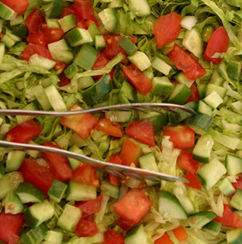
Food Safety
Hot and Cold Holding Temperatures
Holding Temperature is the minimum temperature food must be kept at to prevent bacteria from growing.
Hot foods: > 135°F
Cold foods: < 41°F
Notes:
SPEAKING POINTS:
Hot foods must be held at 135°F (57ºC) or above to keep them warm enough to prevent bacteria from growing. Use steam tables, soup warmers, and heated surfaces. Periodically check the temperature of the food with your thermometer. Stir liquid foods and keep covers on.
Properly cooked roasts may be held at a temperature of 130°F (54ºC) or above.
Cold foods must be held at a temperature of 41°F (5ºC)or below. If ice is used in salad bars or food displays, be sure the ice comes up to the level of the food in the container. The food must be colder than 41°F (5ºC) when you put it on the ice.

Slide 42
Food Safety
Ways to quickly cool food:
Use shallow pans
Separate into smaller, thinner portions
Use rapid cooling equipment
Place in an ice water bath
Use containers that facilitate heat transfer
Loosely cover containers
Notes:
SPEAKING POINTS:
Potentially hazardous cooked food must be cooled quickly – within 2 hours from 135°F (57ºC) to 70°F (21ºC) and within 4 hours from 70°F (21ºC) to 41°F (5ºC).
Cooling must be accomplished with the time and temperature criteria specified by using one or more of these methods based on the type of food being cooled.
Place the food in shallow metal pans with the food no more than 2 inches deep. Thin soups or stocks may be cooled in pans 4 inches deep.
Separate the food into smaller or thinner portions. For example, cut large roasts and turkeys into pieces no larger than 4 pounds.
Use rapid cooling equipment or use ice as an ingredient.
Stir the food in a container placed in an ice water bath. To do this, close the drain in a large sink. Place the metal pot or pan of hot food in the sink. Fill the sink with ice up to the level of the food in the pot and add cold water to the ice. Stir the soup or sauce until it cools all the way to the center.
Use containers that facilitate heat transfer, such as thin metal containers.
When placing food to be cooled in cooling or refrigerated equipment, arrange the food containers in such a way to provide maximum heat transfer through the container walls. Loosely cover to protect from overhead contamination during the cooling period to facilitate heat transfer from the food.

Slide 43
Food Safety
Safe ways to thaw food:
Thaw in a refrigerator
Thaw under running water
Thaw in a microwave
Never thaw food at room temperature
Notes:
SPEAKING POINTS:
Stored frozen foods must be kept frozen.
Potentially hazardous food should be thawed under refrigeration that maintains the food at a temperature of 41°F (5°C) or less. Although this may take a few hours or days, it is the best method. Be sure to place the food in a container that will catch the juices as it thaws.
Potentially hazardous food can also be thawed when completely submerged under running water as long as the water temperature is 70°F (21°C) or below, the water has sufficient velocity to float off loose particles in an overflow, thawed portions of ready-to-eat food do not rise above 41°F (5°C), and raw meat does not go above 41°F (5°C) for more than 4 hours before being cooked.
Food that is frozen can also be thawed in a microwave oven as long as it is immediately transferred to conventional cooking equipment with no interruption in the process.
Never thaw food at room temperature. After a short while, the outside part of the food is in the “danger zone” and bacteria grow while the inside of the food is still thawing.

Slide 44
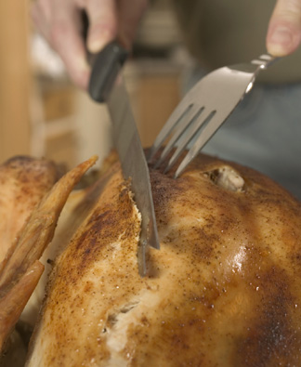
Food Safety
Food that is reheated must reach a minimum internal temperature of at least 165°F.
Reheating must be done rapidly and the minimum temperature must be reached within two hours.

Slide 45
Food Safety
5 Steps of Manual Dishwashing:
Scrape off leftover food
Wash in solution at >110°F (43ºC)
Rinse in clean warm water
Immerse in sanitizing solution
Air dry
Notes:
SPEAKING POINTS:
The only safe way to wash dishes by hand requires a five step process:
Scrape and discard leftover food and grease from dishes, pots, pans, and equipment.
In the first sink, wash the dishes, equipment, and utensils in a wash solution that is maintained at a temperature of 110°F (43ºC) or above or the temperature specified on the cleaning agent manufacturer’s label instructions.
In the second sink, rinse the dishes with clean hot water.
In the third sink, sanitize to destroy bacteria. If immersion in hot water is used for sanitizing in manual washing, the temperature of the water must be maintained at 171°F (77ºC) or above. Chlorine bleach or other chemicals approved by the Public Health Department can also be used as sanitizers.
Air dry the dishes, utensils, and equipment.

Slide 46
Food Safety
Preventing Contamination by Food Handlers
Wash your hands
Use utensils to handle ready-to-eat food
Minimize bare hand contact with exposed food
Use utensil only once when taste testing
Utensils stored to prevent contamination
Linens replaced each time
Wiping cloths cleaned and sanitized
Gloves used for one task
Clean equipment and cutting boards
New plates for second portions
Notes:
SPEAKING POINTS:
Food handling associates play a vital role in preventing food contamination.
Wash your hands and arms often to prevent contamination of food.
Do not touch exposed, ready-to-eat food with your bare hands. Instead, use suitable materials and utensils, such as deli tissue, spatula, tongs, single-use gloves, or dispensing equipment. The only exception is when washing fruits and vegetables.
When handling exposed food that is not in a ready-to-eat form, food associates must take steps to minimize bare hand and arm contact.
When tasting food that is to be sold or served, food associates may only use a utensil once for each taste test.

Slide 47
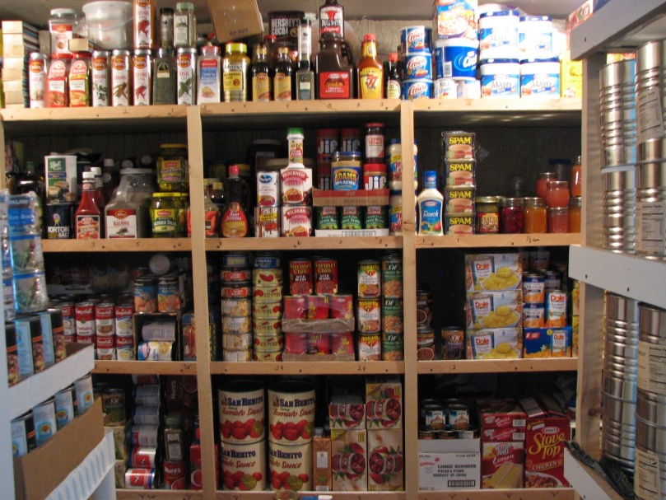
Food Safety
Food Storage
Store food in a clean, dry location.
Store food where it is not exposed to splash, dust, or other contamination.
Store food at least 6 inches above the floor and away from walls.
Keep food stored away from chemicals and cleaning agents.
Rotate the food stock. Use older food first (FIFO – first in , first out).
Notes:
SPEAKING POINTS:
Food must be protected from contamination during storage.
Store food in a clean, dry location.
Store food where it is not exposed to splash, dust, or other contamination.
Store food at least 6 inches above the floor and away from walls.
Keep food stored away from chemicals and cleaning agents.
Rotate the food stock. Use older food first (FIFO – first in , first out).

Slide 48
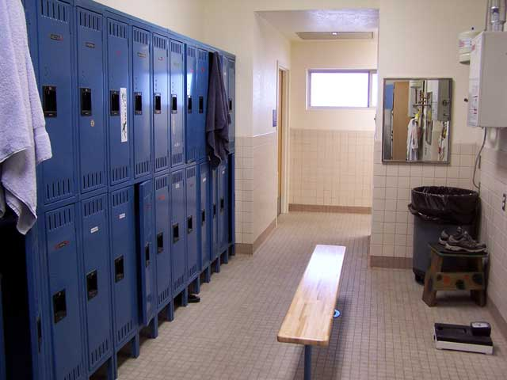
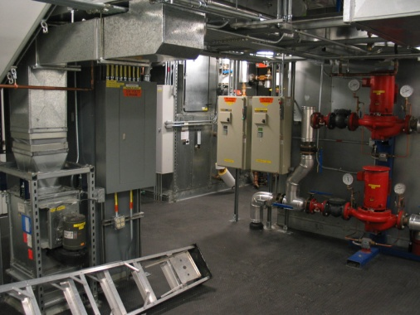
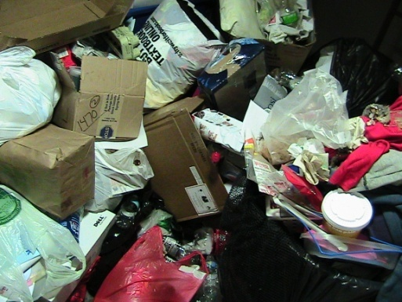
Food Safety
Avoid these storage areas to prevent contamination:
Locker rooms
Restrooms
Garbage rooms
Mechanical rooms
Under water or sewer lines
Under open stairwells
Notes:
SPEAKING POINTS:
Food must be protected from contamination during storage.
Store food in a clean, dry location.
Store food where it is not exposed to splash, dust, or other contamination.
Store food at least 6 inches above the floor and away from walls.
Keep food stored away from chemicals and cleaning agents.
Rotate the food stock. Use older food first (FIFO – first in , first out).

Slide 49
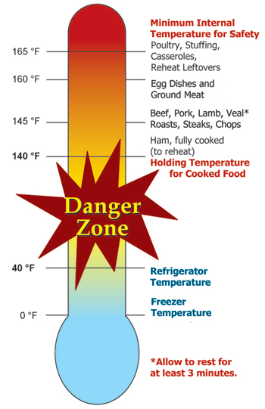
Food Safety
Key points to remember:
Wash hands often
Do not work when you are sick
Keep food out of the “danger zone”
41°F - 140°F
Prevent contamination of food and utensils
Store food properly
Use your thermometer to ensure food is not in the “Danger Zone”
Notes:
SPEAKING POINTS:
These are the main points you should take away from this training session (read slide)…
Wash your hands thoroughly and often.
Do not come to work when you are sick.
Keep food out of the temperature “danger zone.” Food should either be kept cold or hot.
Take steps to prevent the contamination of food, utensils, equipment, etc.
Store food properly.
Use your thermometer often to check food temperatures.
Do you have any questions regarding how to properly receive food, store food, cook food, thaw food, reheat food, and clean dishes, utensils, and equipment in order to prevent food contamination?
OK, now it’s time for a brief quiz.
INSTRUCTOR ACTION: Give trainees the quiz and debrief.

Slide 50
Employee Health Policy Agreement

Slide 51
GuestPath

Slide 52
Notes:
4 Key Elements are 4 behaviors of measurement. Simply put during a guest encounter each associate is expected to demonstrate these 4 Key Behaviors each and every time.
Be ready to serve means we are in proper uniform, we meet our professional appearance standards, we are attentive and ready to take care of our guest needs, we are gracious and friendly, have good product knowledge, work as a team and are professional at all times..
Creating a welcoming environment is: Acknowledging guest in 10’ and greeting them in 5’ with a Welcome and offer of service. Such as “Welcome to Comerica Park, how may I help you”
Personalize the experience is using a guest name when known How can we get guest names?
Finally Demonstrate Gratitude: Provide a thank you and warm farewell> “Thank you, enjoy your day/enjoy the game”
Within the next 30 days you will be expected to complete an on-line workshop for 4 Key Elements of Service Delivery. But in the meantime you will receive a pocket card today you can you to educate yourself on our expectations in regards to customer service.

Slide 53
PCI Training
Notes:
Please enter hyperlink to the PCI compliance training for seasonal associates

Slide 54
What is PCI?
Payment Card Industry
PCI Security Standards Council
Founded by American Express, Master Card, Visa, Discover, and JCB International
PCI Data Security Standard
Notes:
In the “PCI Compliance and You” section, we will review the policies Delaware North has created in relation to the PCI Compliance efforts which most relates to your area of responsibility.

Slide 55
PCI Compliance
What does it mean to be PCI Compliant?
Achieving and maintaining the requirements of the PCI Security Standards Council
Mandated by major credit cards companies or we lose our privileges
Protect Credit Card Information
Notes:
SPEAKER: What does it mean to be PCI Compliant?
There are multiple points that your information may be compromised. Think about the last time you made a purchase with your credit card. Let’s say you bought a new shirt at the GAP. You go up the counter and give the sales clerk your credit card. He or she takes your card, swipes it through their POS system which captures your card information. A receipt is printed and in some cases you need to sign, in some cases you don’t. Then he or she hands you back your card. Now, your information travels from that POS system to a storage drive somewhere on the GAP network until it gets sent through to the bank processor at the end of the day with the hundreds of other credit card transactions. Throughout that process, there are multiple points that your information is compromised. From the second the clerk takes your card, to how your data is stored on their systems.
PCI Compliance standards work to protect your data every step of the way- from the procedure the sales clerk uses when handling your card to the software in the computer your credit card information is stored until it gets sent to the bank processor. The standards limit access to computer systems that house credit card data and calls for increased security measures.
(pull-up first bullet) So, a company is PCI Compliant when they have achieved and can maintain the requirements or those standards set forth by the Council.
All merchants that utilize credit cards must be PCI Compliant and it applies to all channels: retail, F&B, lodging, etc. and all forms of credit card processing: e-commerce, telephone, over-the-counter, etc.
(pull up second bullet) In other words, when you are PCI compliant, you use the most secure measures possible to protect credit card information. You safeguard it as you would your social security number or your life savings.

Slide 56
Why being PCI Compliant is critical?
It’s the right thing to do based on the million of records being breached recently
Maintain Delaware North’s reputation of integrity
We are all responsible for PCI compliance
Mandated by major credit cards companies or we lose our privileges

Slide 57
General Handling Procedures
Obtain signature for transactions over $50.00 for F&B and over $100.00 for Retail
Ask guest if they want a copy of receipt
Secure merchant copy of receipt in cash drawer until the end of the shift
BAR TABS PERMITTED IN CERTAIN AREAS ONLY

Slide 58
General Handling Procedures
The cashier will verify that the guest has signed the back of the card.
If the guest has not signed the back of the card, the cashier will ask the guest to produce valid government-issued photo identification. The cashier will compare the name on the photo identification to the name on the credit card.
If "See ID" or “Ask for ID” is written in the signature line on the back of the card (in place of the cardholders signature), it will be acceptable, so long as the guest provides valid identification.

Slide 59
Lost Credit Cards
Give to a supervisor immediately
If a supervisor not available:
Place in sealed envelope
Write name on the card on the envelope
Place in locked drawer or cabinet until you can give to a supervisor

Slide 60
Field Incident Response Plan
What constitutes a credit card breach or “incident”?
Physical theft or loss of processing device
Physical theft of loss of hard copy/paper record information
Unauthorized access, tampering or suspicious activities in “sensitive areas.”
Failure to account for proper disposal of hard copy/paper records with full credit card information
Third party service provider breaches

Slide 61
Field Incident Response Plan
Responsibility of every Delaware North Companies’ associate/NPO member to report any potential incidents
To report the incident, call the Delaware North Associate Hotline:
1-800-441-5645

Slide 62
What did we review today?
Who Delaware North is and how DN grew to be the company we are today
How NPOs treat our external guests
How NPOs treat the environment
How NPOs treat our internal guests – including the policies and procedures we follow to ensure our workplace is a positive work environment
Introduction to how Delaware North operates

Slide 63
Alcohol Training
Notes:
As of Oct 2017 – this is a placeholder for what you are currently using for alcohol training at your unit.
Look forward to more recommendations for best practice in this area of training in the future

Slide 64
Alcohol Service
Delaware North Sportservice – Carolina Panthers is committed to doing what we can to ensure that our fans’ experience at the stadium is enjoyable, positive, and safe. In order for that to happen, we work to provide all volunteer with the training, tools, and information they need to service our fans. The safe service of alcohol is everyone’s responsibility. In this training session, you will learn what you can do to reduce alcohol related incidents and be a responsible seller/server of alcohol.

Slide 65
Alcohol Service
Selling alcohol to someone under 21 is a misdemeanor.
If convicted, you will have a criminal record. You will also be unable to work in any place that sells alcohol for two years. Besides a bar or restaurant, this includes convenience stores, markets, catered events, etc.
If you sell to an underage or intoxicated person and injury or death results, you may be sued for up to $500,000.
If you sell to an underage or intoxicated person and injury or death results, there is no limit to the amount you may be sued for in a civil suit.
It is in the best interest of every employee to prevent alcohol related incidents from occurring.
In addition to any penalties imposed by North Carolina and the Alcohol Law Enforcement, violation of any state and stadium alcohol service policies will result in your termination from Delaware North Sportservice.

Slide 66
Alcohol Service
4 Valid Forms of Identification
Any US state driver’s license
A North Carolina state (ONLY) ID card
A Domestic/Foreign passport
A Military identification card
YOU MUST ID EVERYONE WHO APPEARS TO BE 40 YEARS OF AGE OR YOUNGER.

Slide 67
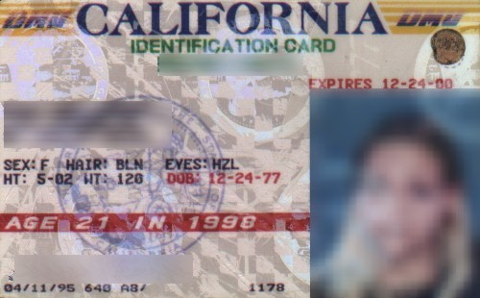
Activity: Identifying Acceptable IDs
Is this an acceptable form of identification?
NO!

Slide 68
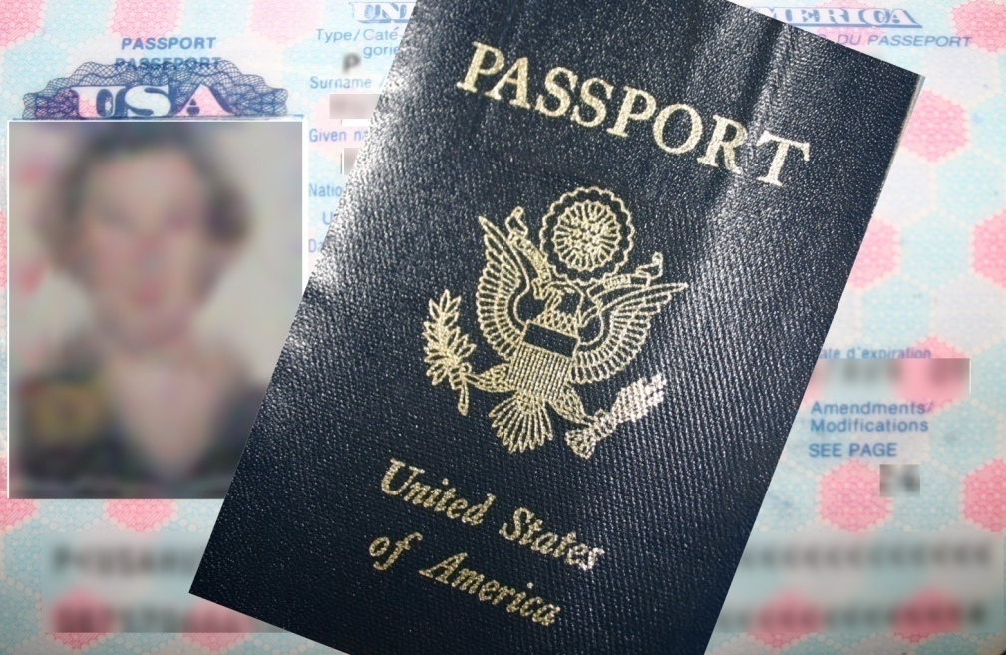
Activity: Identifying Acceptable IDs
Is this an acceptable form of identification?
YES!

Slide 69
Activity: Identifying Acceptable IDs
P—Photo: Look at the photo to see if it matches the person
A—Age: Compute the age
U—Under Age: Is the person under age?
S—Seal: Check the seal or hologram
E—Examine: Examine the ID for irregularities

Slide 70
Alcohol Service
If you ask a fan to see their ID, and they do not have a valid form of ID, you can not serve them alcohol.
Legally, anyone consuming or serving alcohol, regardless of their age, is required to have a valid form of ID with them at all times.
If you recognize a fake ID, do NOT return the ID to the fan and let them know that you to verify their ID. Then, inform your supervisor or a police officer or member of security.
Management will support your decision if you deny alcohol service to a fan. Alcohol service is a privilege, not a right.

Slide 71
How to refuse alcohol service
State in a calm and business-like way that you cannot sell them alcohol.
If challenged, tell them
You are unable to legally serve them another drink.
Offer a non alcoholic alternative.
Get assistance from Stand Manager if the situation escalates.

Slide 72
Alcohol Service
A fan may only purchase two alcoholic beverages at a time, or one per hand. If they already have a drink in their hand, you may only sell them one more.
Cups may NOT be refilled.
We do NOT sell doubles.
We do NOT sell shots.
We do NOT sell multi-liquor drinks
To preserve our fan and family-friendly atmosphere, glass containers are not permitted in public areas of the stadium; beverages in these containers must be poured into a plastic cup. And, the tops must be removed from all bottled alcoholic beverages.
Remember, it is your responsibility to ensure the safe consumption of alcohol in the stadium.

Slide 73
Alcohol Service
Swaying or staggering
Stumbling or bumping into things
Leaning on objects for support
Glassy eyes
Slurred speech
Annoying other customers
Difficulty handling money
Overlooking ID in wallet

Slide 74
Dealing with Problem Situations
Make sure you know the stadium and company policies, but always remember that YOU are responsible if you sell alcohol.
State in a calm and business-like way what the problem is and repeat what you are going to do (or not do).
Do not argue with anyone. If possible, step away from the counter.
Call your Stand Manager to handle the customer.
Call the police if the situation becomes heated or if you feel threatened.

Slide 75
Key Points to Remember
You can refuse to sell alcohol to anyone.
Do not sell to anyone who is under 21 or visibly intoxicated.
Ask for ID from anyone who looks under 40.
No more than 2 drinks per person per sale at one time. If guest already has a drink in one hand then only 1 can be sold to patron.
All Alcohol service end at the end of the 3rd Quarter.

Slide 76
Alcohol Service
Fans must be 21 years old or older to purchase and/or consume alcohol.
Anyone serving alcohol must be 18 years old or older.
Check EVERYONE’S ID WHO APPEARS 40 YEARS OF AGE OR YOUNGER.
You may sell only two alcoholic beverages at a time per person, or one drink per hand. If they have an alcoholic beverage in their hand, you may only sell them one more.
Know where the alcohol is going. Watch for fans giving drinks to others who may not be of age, or setting drinks down and immediately coming back for another round.
Alcohol sales stop at the end of the 3rd quarter; once the 4th quarter begins no more alcohol may be sold. In private areas, like luxury suites and Suite 87, guests may be served until the area closes.
Employees must remove the tops from all bottled beers. Glass containers are not permitted in public areas of the stadium; beverages in theses containers must be poured into a plastic cup.
If you decline service to a fan, immediately notify your supervisor. SF&B will back your decision by 100%.
It is your responsibility to ensure fans do not over-consume alcohol while at Bank of America Stadium, but we must all work together to prevent alcohol related incidents.

Slide 77
Questions?

